Slide 1
CHILEAN SPANISH
Lluïsa Astruc¹,
Héctor Ortiz²,
Marcela Fuentes³
The Open University-Cambridge University¹, Universidad Metropolitana de Ciencias de la Educación-Universidad de Santiago de Chile², Universidad Cardenal Silva Henríquez³

Slide 2
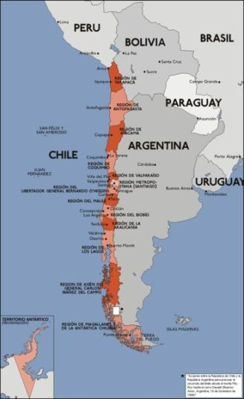
Corpus
3 speakers from Santiago
Acoustic analysis with Praat

Slide 3
1. Pitch accents

Slide 4
Pitch accents
Monotonal
Bitonal
H*
L*
?
L+H*
L+>H*
L*+H
H+L*

Slide 5
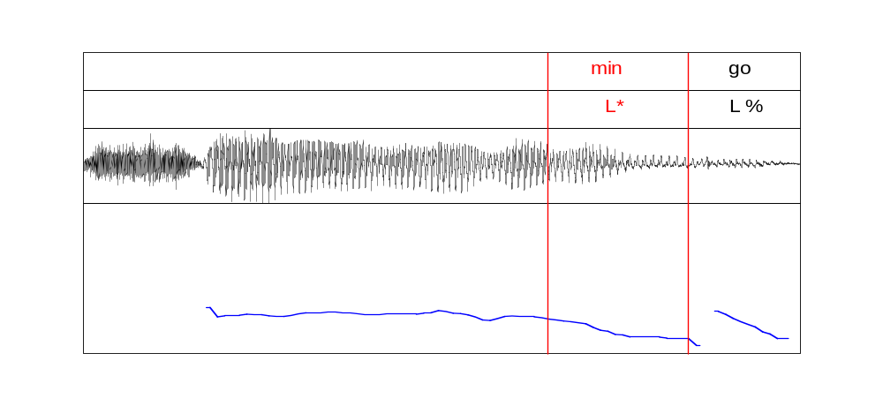

Pitch accents: L*
[…] sábado y domingo.
L* L%
L*
Nuclear accent: last item in closed enumeration

Slide 6
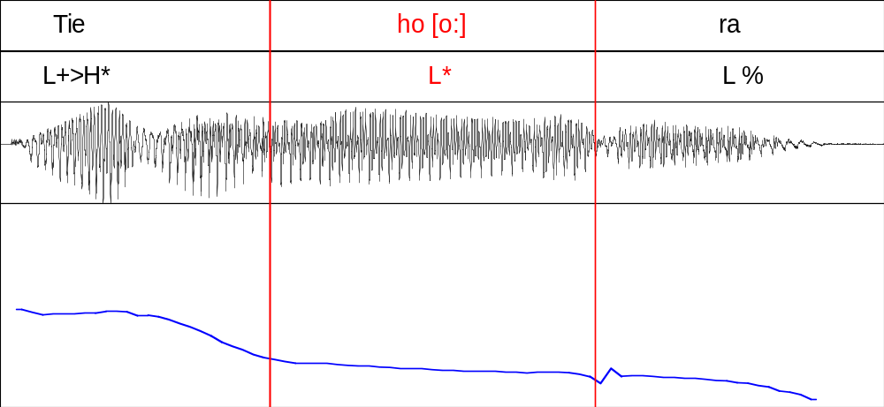
Pitch accents: L*
¿Tiene hora?
L* L%
L*
Nuclear accent: absolute interrogative (neutral);
interrogative (confirmation)

Slide 7
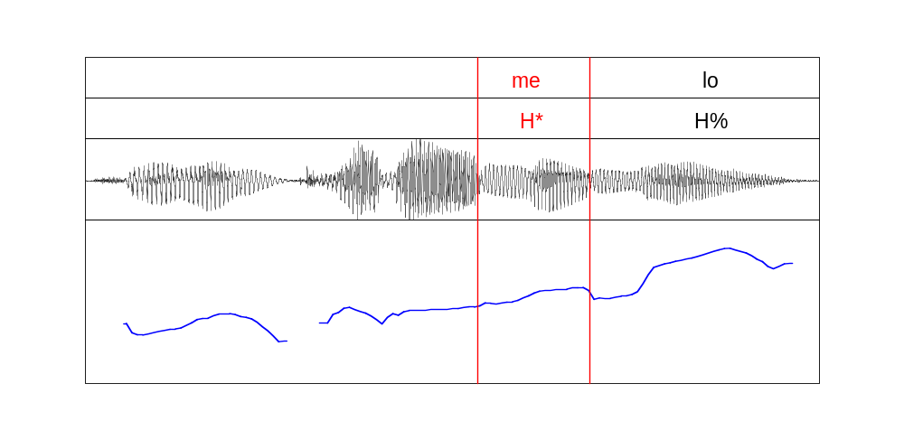
Pitch accents: H*
¿Quieren caramelos?
H* H%
H*
Nuclear accent: invitations; polite questions;
open enumerations.

Slide 8
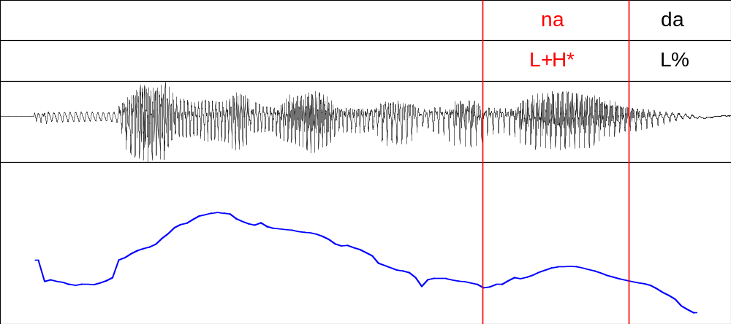
Pitch accents: L+!H*
Bebe una limonada
L+!H* L%
L+!H*
L+!H*
Pitch accent: declarative (neutral)

Slide 9
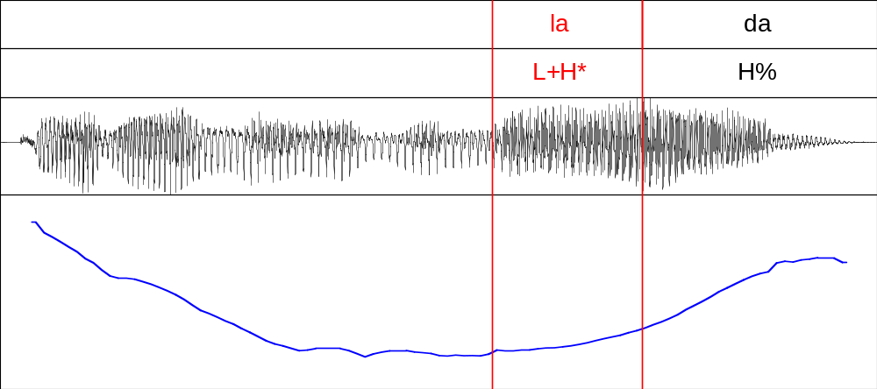
Pitch accent: L+H*
¿Tiene mermelada?
L+H* H%
L+H*
Nuclear accent: absolute interrogative (polite)

Slide 10
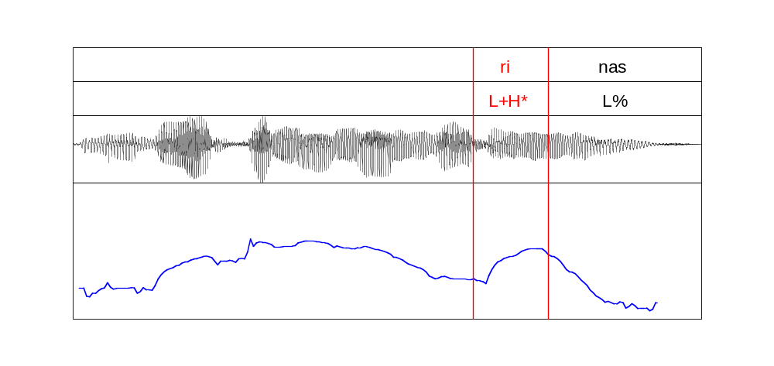
Pitch accents: L+H*
María come mandarinas
L+H* L%
L+H*
Nuclear accent: declarative (non-neutral)

Slide 11
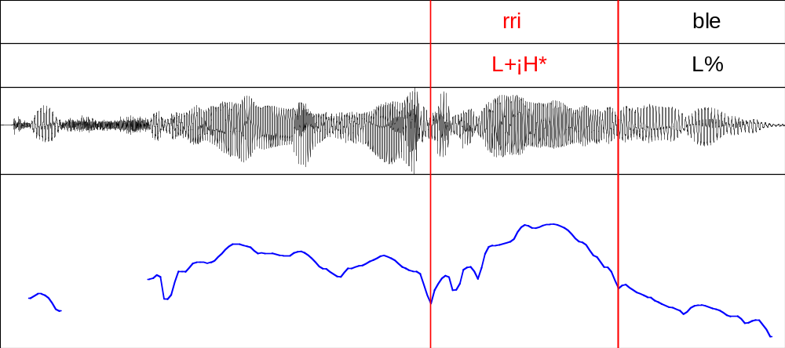
Pitch accents: L+¡H*
¡Qué frío más horrible!
L+¡H* L%
L+¡H*
Nuclear accent: exclamation

Slide 12
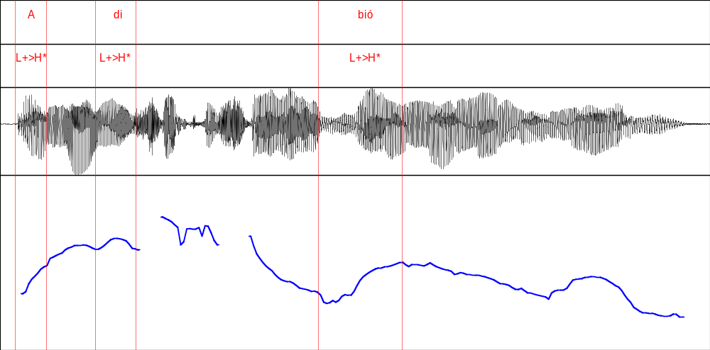
Pitch accents: L+>H*
Ana dice que se bebió una limonada
(L)+>H* L+>H* L+>H*
L+>H*
Prenuclear accents: declarative in broad focus; imperatives; requests; interrogative (all types)

Slide 13
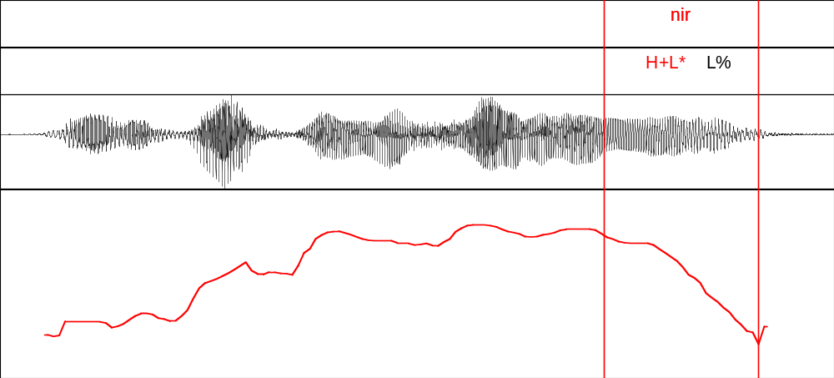
Pitch accents: H+L*
¿Verdad que vas a venir?
H+L* L%
H+L*
Nuclear accent: absolute interrogative (confirmation)

Slide 14
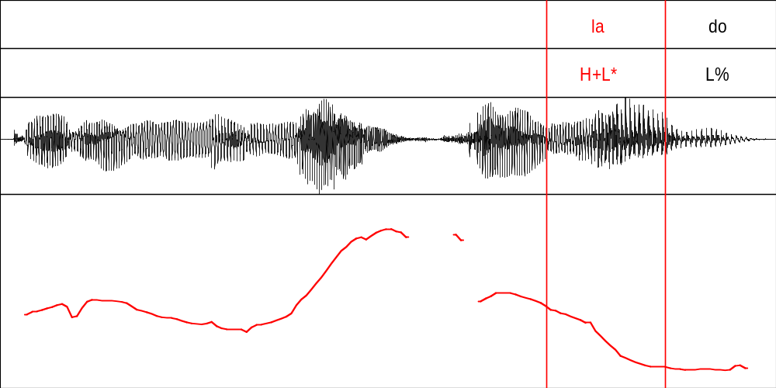
Pitch accents: H+L*
¿Quieren melón o helado?
H+L* L%
H+L*
Nuclear accent: interrogative (disjunctive)

Slide 15
2. Boundary tones

Slide 16
Sp_ToBI proposal: boundary tone combinations
Monotonal
Bitonal
H%
L%
M%
HH%
LH%

Slide 17
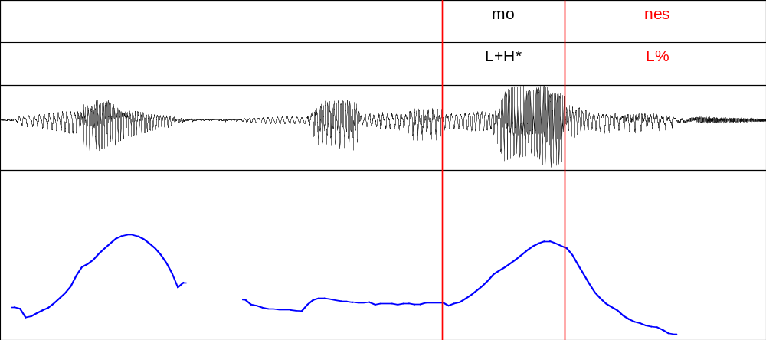

Boundary tones: L%
No, de limones
L+H* L%
L%
Declarative (contrastive focus)

Slide 18
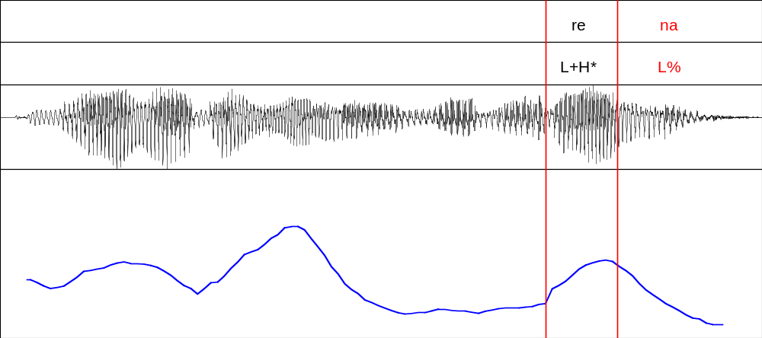
Boundary tones: L%
Vi a Marina, la morena
L+!H* L%
L%
L+!H*
Declarative: aposition

Slide 19
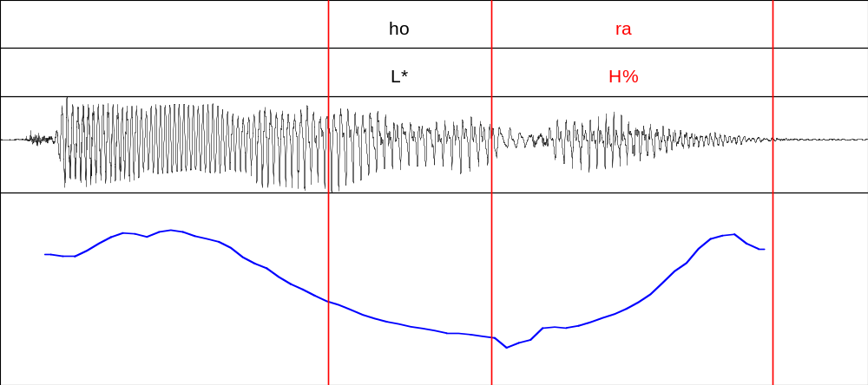
Boundary tones: H%
H%
¿Tiene hora?
L* H%
Interrogative (neutral)

Slide 20
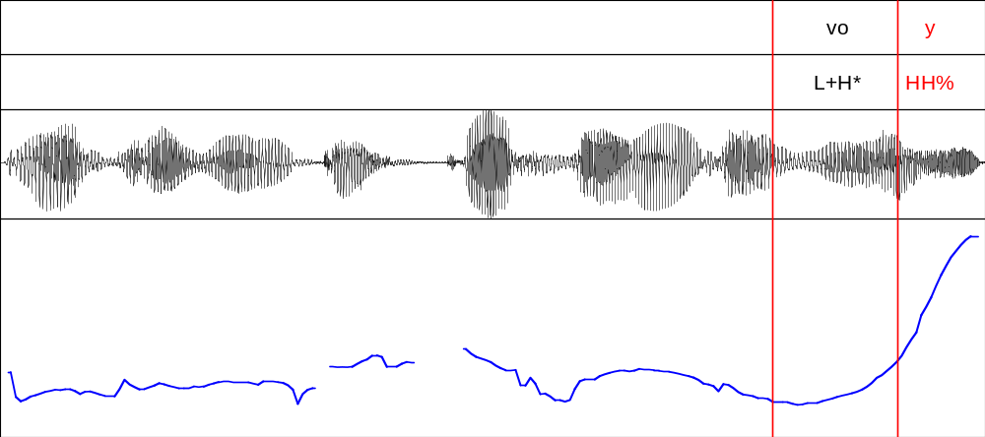
Boundary tones: HH%
HH%
¿Me preguntaste dónde voy?
L+H* HH%
Interrogative (reiterative)

Slide 21
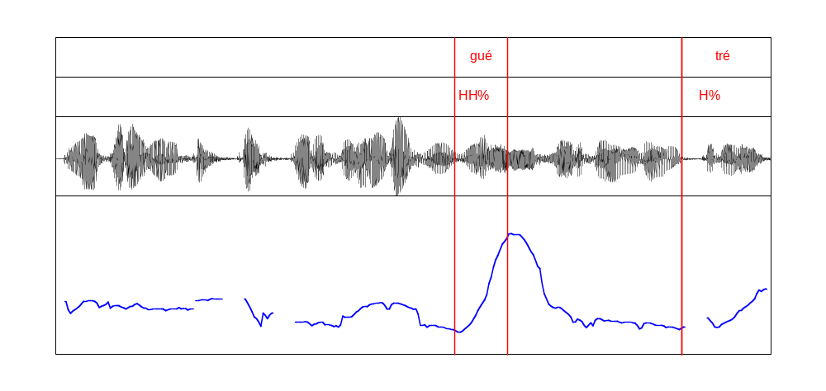
Boundary tones: HH% vs H%
¿Me preguntaste por dónde llegué, o por dónde entré?
L+H* HH% L+H* H%
Interrogative (reiterative disjunctive)

Slide 22
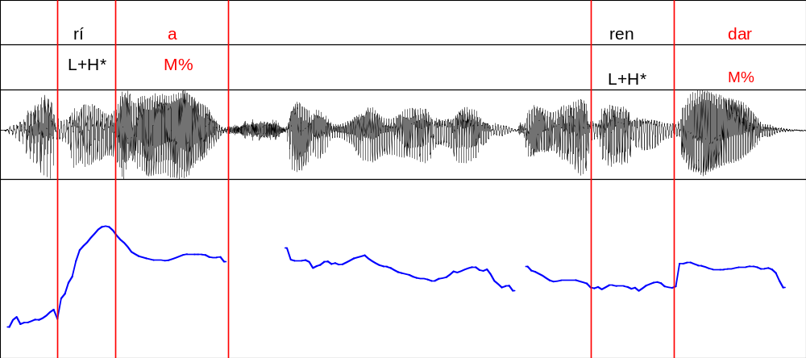
Boundary tones: M%
María, salgo un momento a merendar.
L+H* M% L+H* M%
M%
Vocative (calling at a distance)

Slide 23
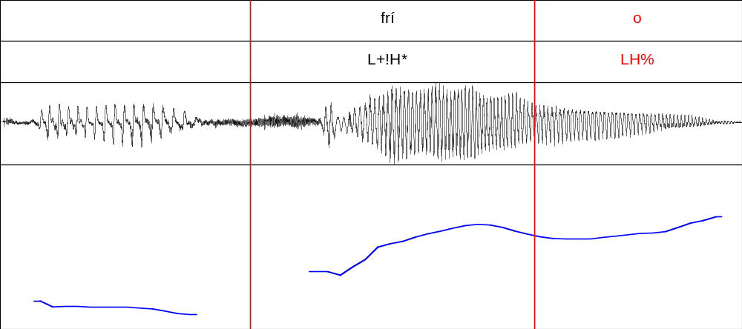

Bitonal boundary tones: LH%
¡¿Tienes frío?!
L+!H* LH%
LH%
Interrogative (exclamative)

Slide 24
Summary of nuclear configurations (Chilean Spanish)
Sp_ToBI (Ch)
Schematic
Representation
Phrase type
L* L%
Enumeration (last item); absolute interrogative (neutral and polite).
Absolute interrogative (politeness); open enumeration;
imperative interrogative (invitation).
H* H%
L+(!)H* L%
Neutral declarative; interrogative (exclamatory); imperative interrogative (protest).
L+¡H* L%
Declarative (exclamatory)
L+H* H%
Interrogative (2nd item, reiterative, disjunctive)

Slide 25
Resumen: configuraciones nucleares (Chilean Spanish)
Sp_ToBI (Ch)
Schematic Representation
Phrase type
Interrogative (absolute: imperative, invitation); reiterative (exclamation)
L+>H* H%
Interrogative (absolute: seeking confirmation); partial interrogative (rhetorical).
H+L* L%
H+L* HH%
Interrogative (absolute, reiterative)
L+H* M%
Interrogative (exclamatory); vocative (at a distance).

Slide 26
Conclusions
1. Pitch accents found in corpus:
• Monotonal: H*, L*
• Bitonal: L+H*, L+>H*, H+L*
2. L+H* is the most frequent pitch accent both as prenuclear and nuclear.
• No evidence found to postulate L*+H.
• No evidence found of the triple distinction of rising pitch accents L+H*, L+>H* and L*+H.
3. Boundary tones found in corpus
• Monotonal: H%, L%, M%
• Bitonal: HH%, LH%
4. Evidence was found to distinguish between H% and HH%.
• No evidence found to postulate HL%.

